Slide 1

The giving hands
Social welfare system

Slide 2
team
GAYATRI
PRACHI
Group Project BG-18
By:
Gayatri Dhanwani. 218819
Prachi Dube. 218821

Slide 3
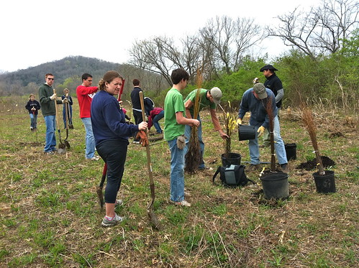

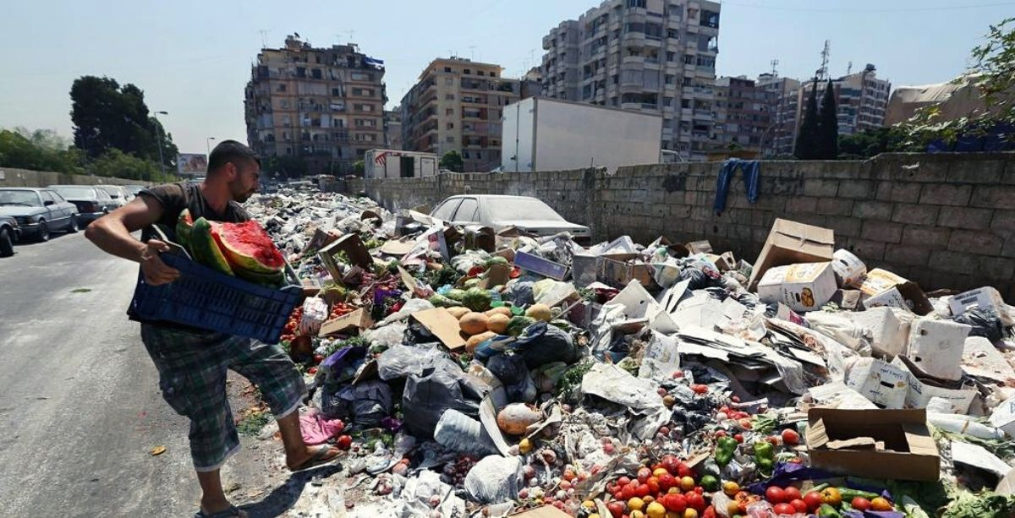
Introduction
This project provides a platform to work sincerely for people in humanity without discrimination and to provide a forum for exchange of ideas social welfare.
Here people can voluntarily participate and enroll for the activities they wish. After completing certain tasks we provide certificates to the members to motivate their work!
It is website which contains three modules:
Waste management.
Tree plantation.
Charity.

Slide 4

Proposed system: Our project offers a platform where you can willingly contribute for the betterment of tomorrow. In our project we have designed three different modules, waste management, tree plantation and charity. This website is designed in such a way that it is easy to access.

Slide 5
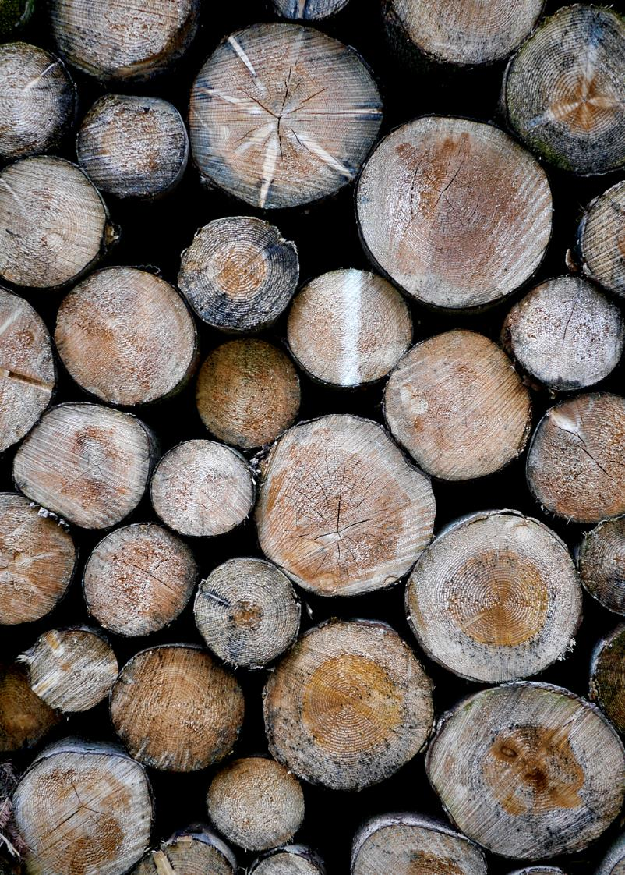
Features
Open source website
Login/Register page for users
Easy accessibility and retrieval of data for both parties.
Fresh, quality content
Ensuring easy navigation
Certified sessions
24/7 accessibility

Slide 6
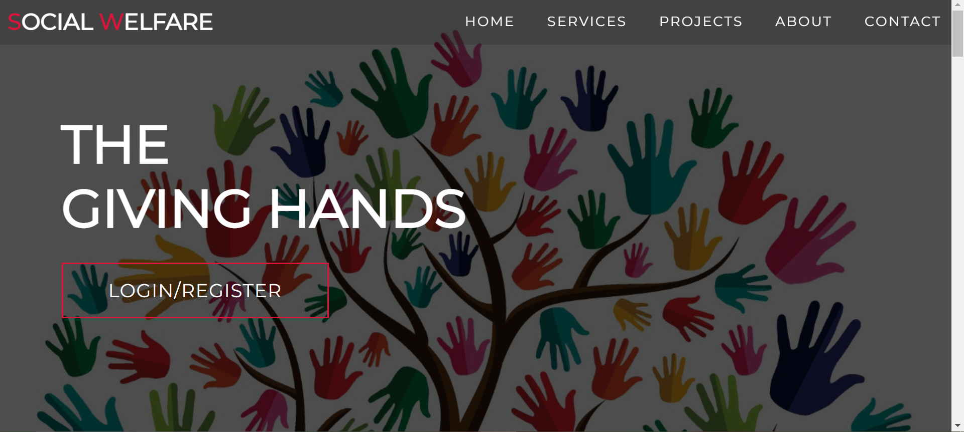
Login dashboard

Slide 7
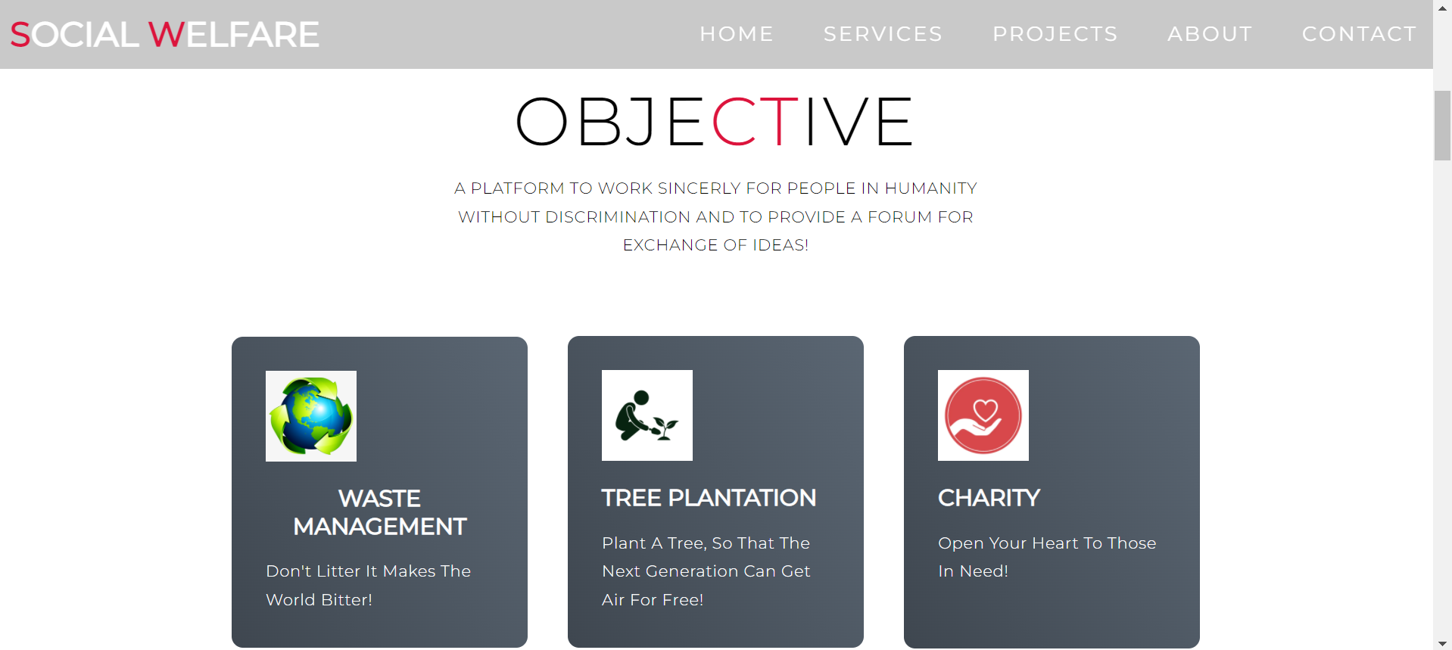
Three modules dashboard

Slide 8
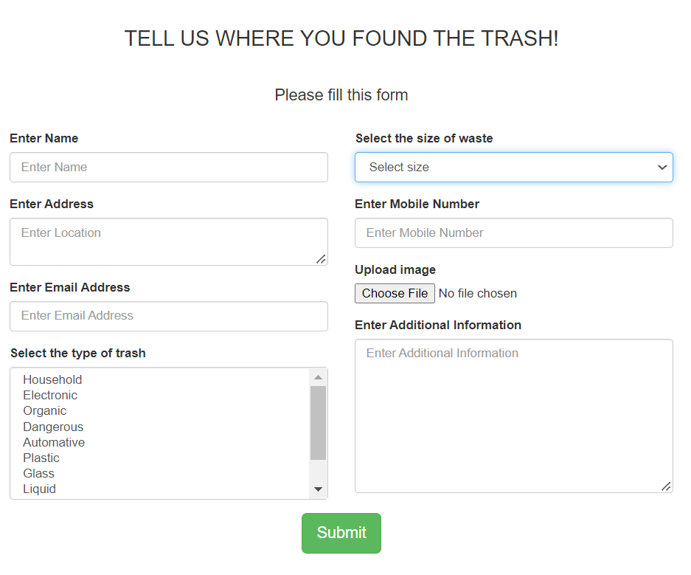
Waste management: Through this module you can register yourself for a particular cleanup session . Also you can simply inform the location where the trash is found, and mention the type and size of the trash to be collected. user will receive a pop up message once done

Slide 9
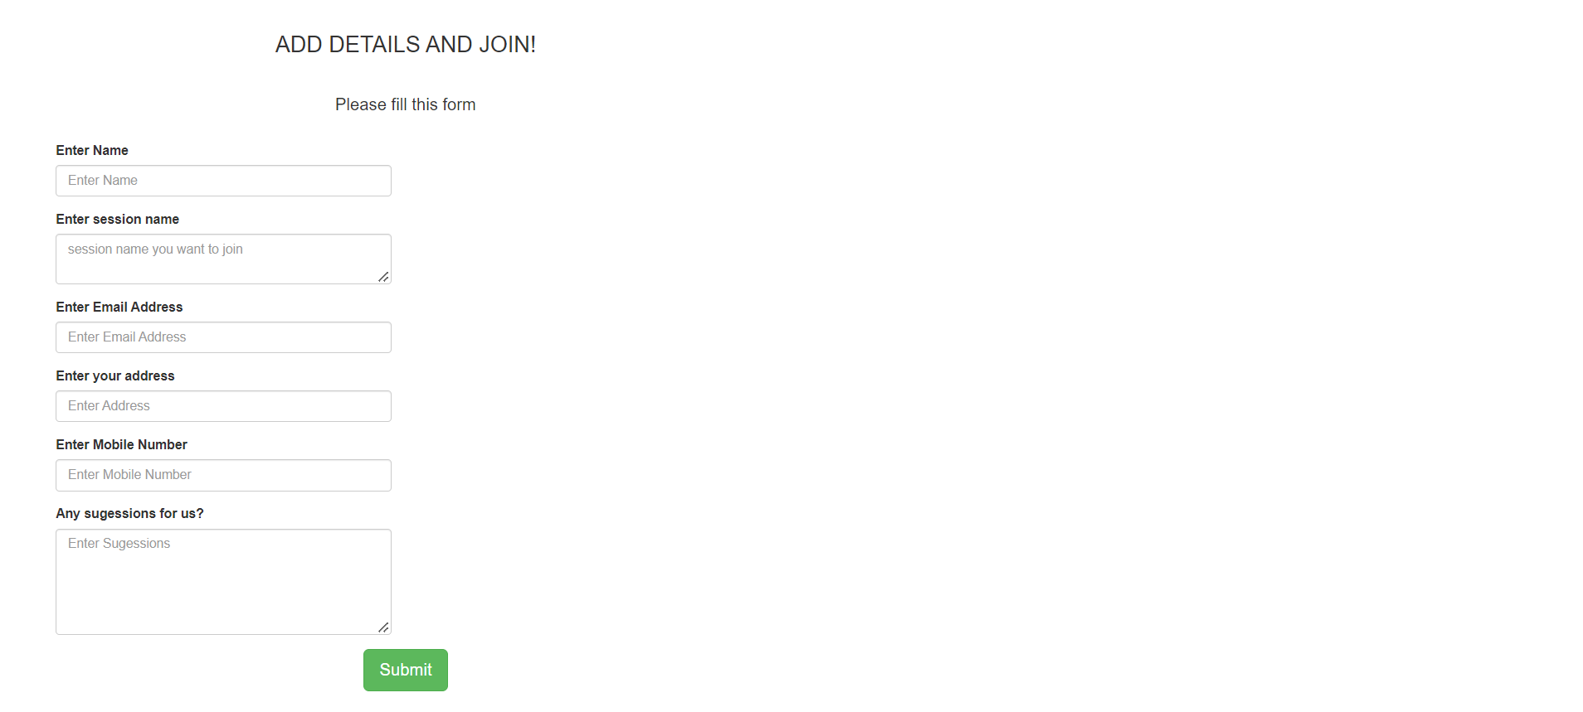
TREE PLANTATION: Here you can get the updates about the plantation sessions taking place nearby with date, time and location. User can register themselves for any particular plantation session they wish. .

Slide 10
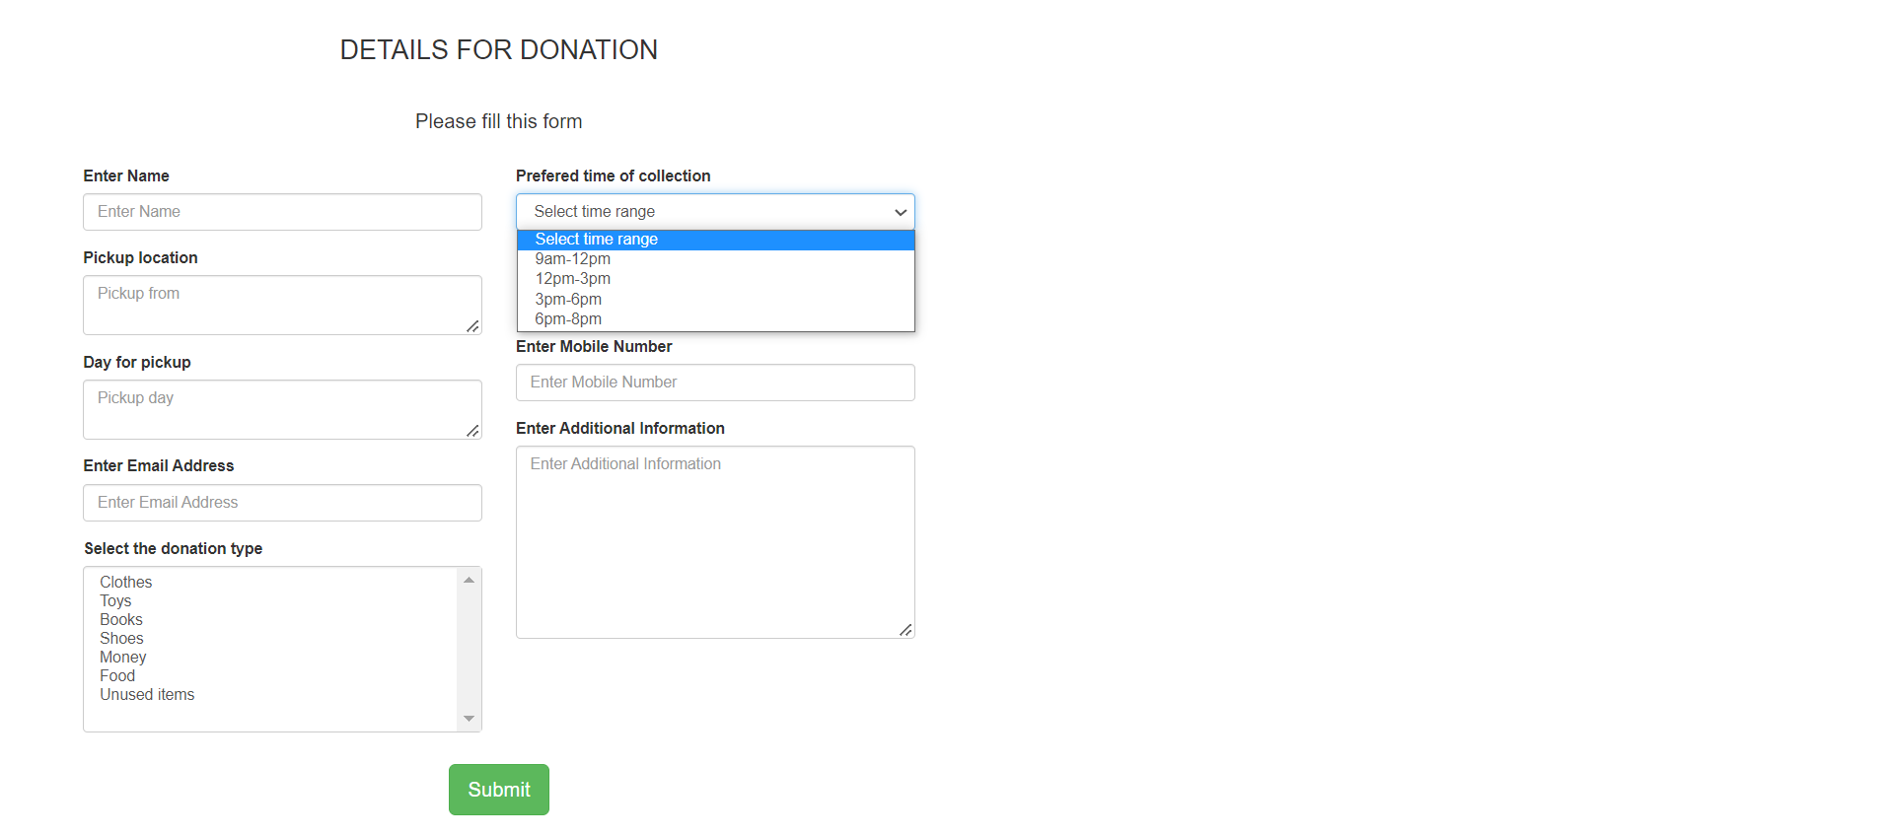
charity: trough this module you can register yourself for making the donation. The user has to mention the type of item, number of item, address from where it is to be collected and also the preferable time of collection.

Slide 11
Technologies used:
FRONTEND | BACKEND | DATABASE
HTML
CSS | PHP | SQL
JAVASCRIPT

Slide 12

REGARDS,
BG18

